Slide 1
Group ID – 6 Question No. - 6
Members
Abhijeet Sonkar IIB2019009
Aditya Aggarwal IIT2019210
Ambika Singh IIB2019017
Avneesh Kumar IIB2019010
Divy Agrawal IIT2019211

Slide 2
Operating Systems Lab 1

Slide 3

Problem Statement
Remove all files of a specified type (like: ‘txt’) from a specified directory and all of its subdirectories. Print the number of files deleted and the full pathnames of all files deleted. The program must prompt the user to confirm before deleting every file.

Slide 4
TABLE OF CONTENTS
01
02
03
Problem Overview
Code & Explanation
Output Screenshots

Slide 5

Here, we are required to create a bash program to remove some files of specified extension from a specified directory.
These files(of given extension) also need to be deleted from all the subdirectories of the given directory.
User will be asked to enter a directory or path and file extension to be deleted.
Our bash program will have to search for all of those sub-directories of a given directory where the files of a given extension exists.

Slide 6
When the program will encounter the file with a given extension, bash program will ask the user to confirm the deletion of the file.
- If a user presses “Y” or “y” a particular file is deleted, the absolute path of the file is printed, and the number of deleted files is increased by 1.
- If the user presses “N” or “n” file is not deleted.
This process is to be repeated for every file of the specified extension.
At the end, the program should print the total number of files deleted of the given extension.

Slide 7
03 Code & Explanation
The absolute path of the directory will be stored in variable name dir.
It is taken as input from user by using read
#!/bin/bash
dir=" "
echo -n Enter the absolute path of the directory :
read dir
cd $dir
filesDeleted=0
extension=" "
echo -n Enter the extension you want to delete :
read extension
Command to go to the directory $dir
Variable to store no. of deleted files
File type to be deleted will be stored in variable named extension.
read is used to take input from user.

Slide 8
Code & Explanation (contd..)
Here IFS stands for Internal Field Separator, is an environment variable. Its default values are tabs, spaces, and newlines, etc.
IFS=$'\n' is will handle newlines, if loop encounters any tab or space in any file or folder name it will not split its name. Ex- File or folder name like ‘hello world in css’ will be treated as a single file name.
IFS=$'\n'
for ITEM in `find ./| grep "\\.$extension$"`
‘find ./’ command lists files and folders in a directory and its sub-directories in current directory that was given by user
grep searches for a PATTERN in files and folders, by default it prints the matching line.
`grep $extension$` is a REGULAR EXPRESSION for a string that has the given extension at the end of the line.
`grep "\\.$extension$"` will search only for files and will also select the folders whose names ends with that extension.
| is called PIPE, used to combine two commands, here it combines `find ./` with `grep "\\.$extension$"` and in result we get a list of files that end with required extension and also the folders whose names ends with that extension.
Then using a loop we iterate through each element of list one by one

Slide 9
Code & Explanation (contd..)
realpath gives the exact path of ITEM.
basename gives filename from absolute path
do
abspath=`realpath $ITEM`
itemname=`basename $abspath`
if [ -d $abspath ];
then
continue
fi
input=' '
echo -n Do you want to delete $itemname?[Y/N]
read input
If abspath of ITEM is detected as a directory then further code is skipped and next ITEM is processed.
If ITEM is detected as file, then user is prompted to confirm the deletion of file by entering Y or N.

Slide 10
Code & Explanation (contd..)
Checks if value entered by user is Y or y
if [[ $input == 'y' || $input == 'Y' ]];
then
rm $abspath
echo Name of the file delete : $itemname
echo Absolute path of the file : $abspath
echo [ Deletion Successful ]
filesDeleted="$[filesDeleted+1]"
echo
rm command removes/deletes the file
itemname and its absolute path are printed on screen with a [ Deletion Successful ] message
After the deletion, number of files deleted is incremented by 1

Slide 11
Code & Explanation (contd..)
When check for Y or y fails, program checks for N or n, and if this check passes, [ FILE NOT DELETED ] message is printed
elif [[ $input == 'n' || $input == 'N' ]];
then
echo [ FILE NOT DELETED ]
echo
else
echo [ INVALID INPUT – FILE NOT DELETED ]
echo
fi
done
When user enters anything other than Y or N or y or n, [ INVALID INPUT ] message is printed.
fi is compulsory statement to end if-else statements
done is necessary statement to denote end of for-loop

Slide 12
Code & Explanation (contd..)
Resets IFS environment variable to its default values.
unset IFS
echo -n "Number of files deleted : " $filesDeleted
echo
exit 0
Prints the number of files deleted in complete process.
Basic command to exit from bash program.

Slide 13
04 Output
Next few slides will contain screenshots of output, and last slide will contain a small video showing the complete output.

Slide 14
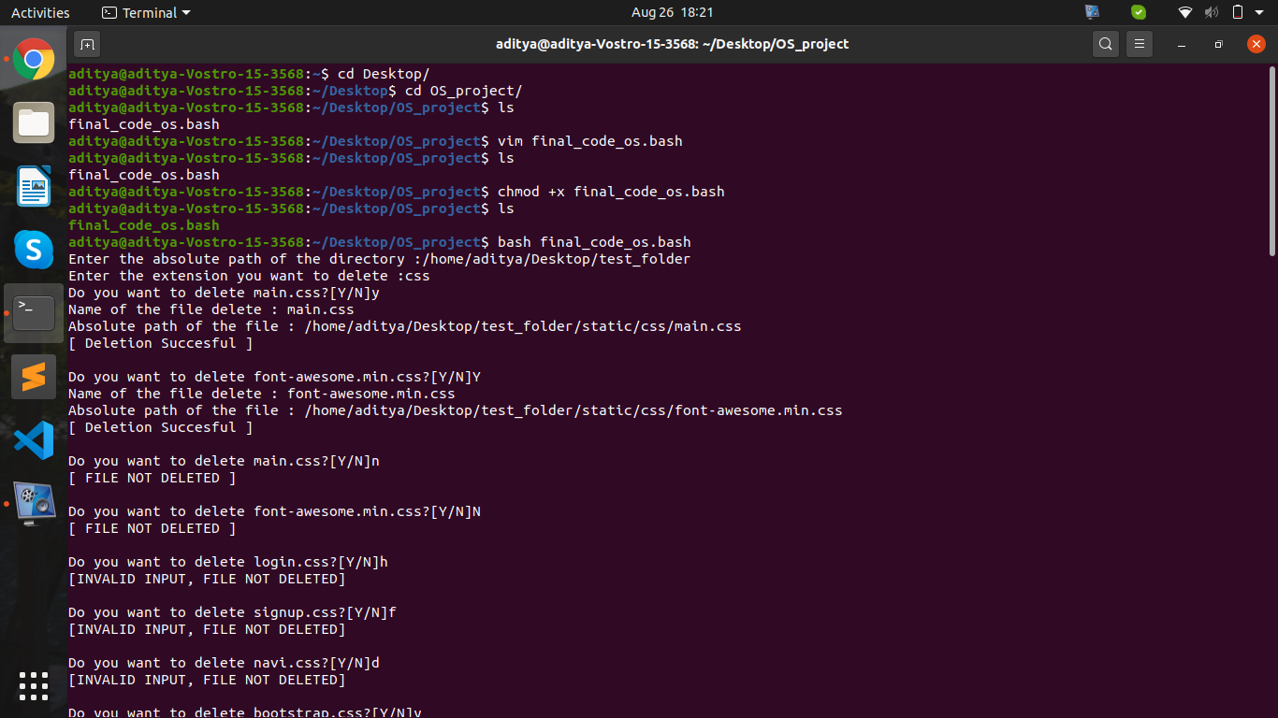

Slide 15
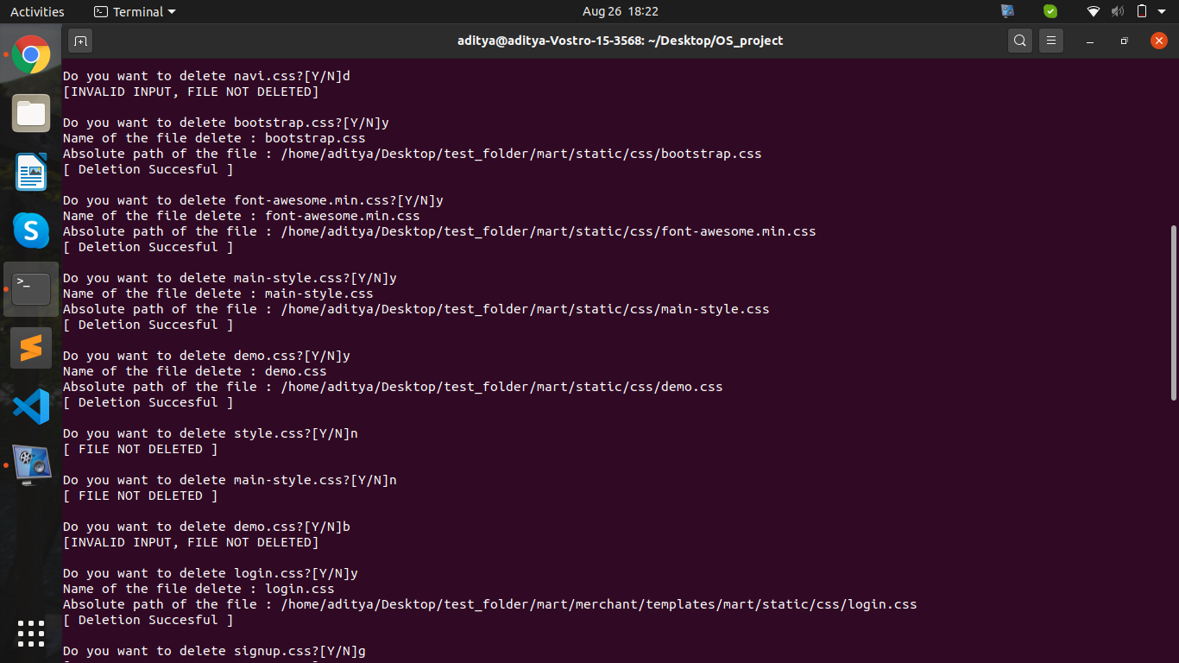

Slide 16
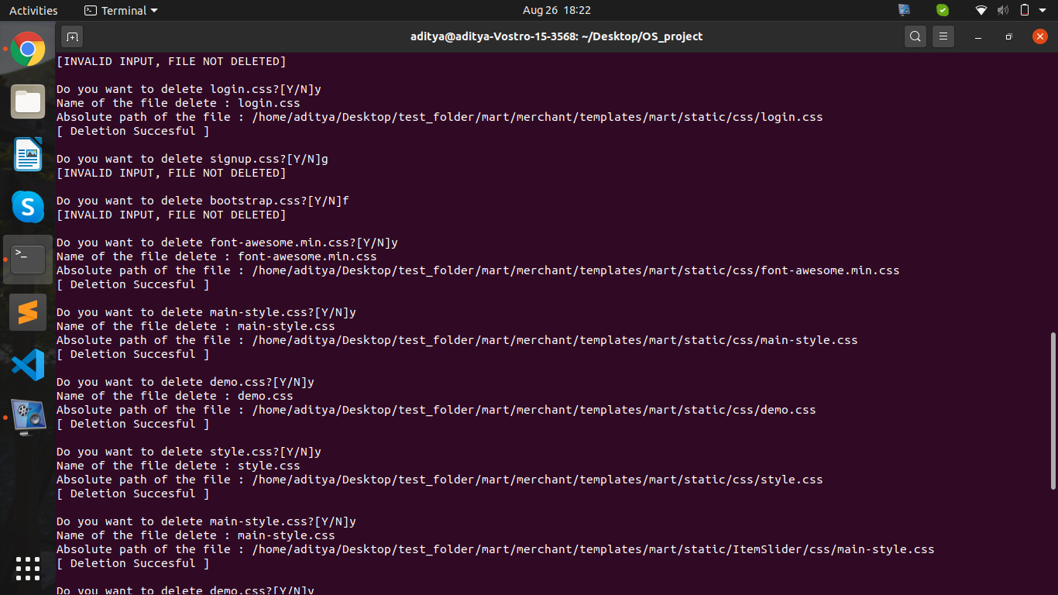

Slide 17
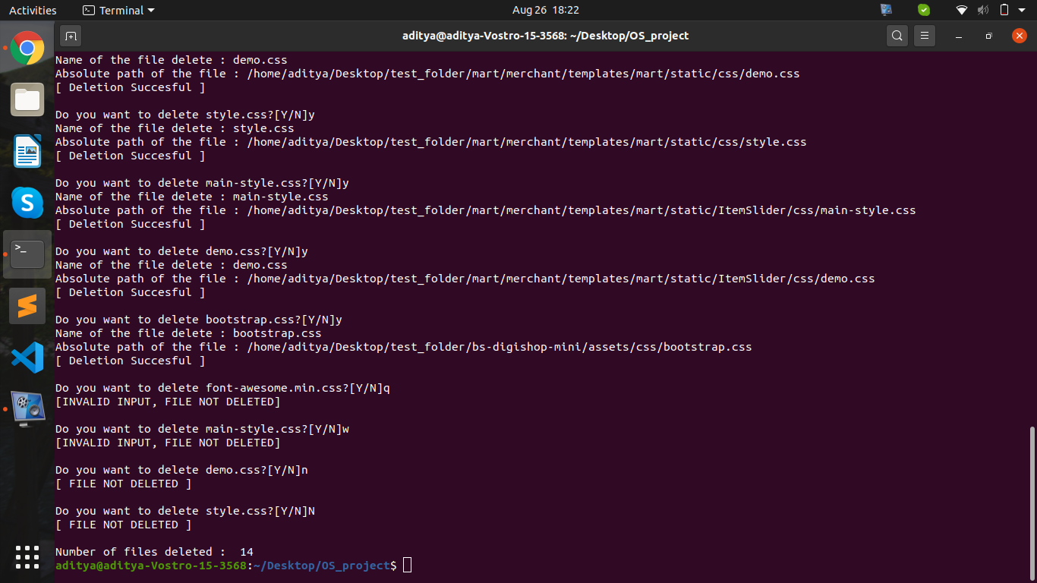

Slide 18
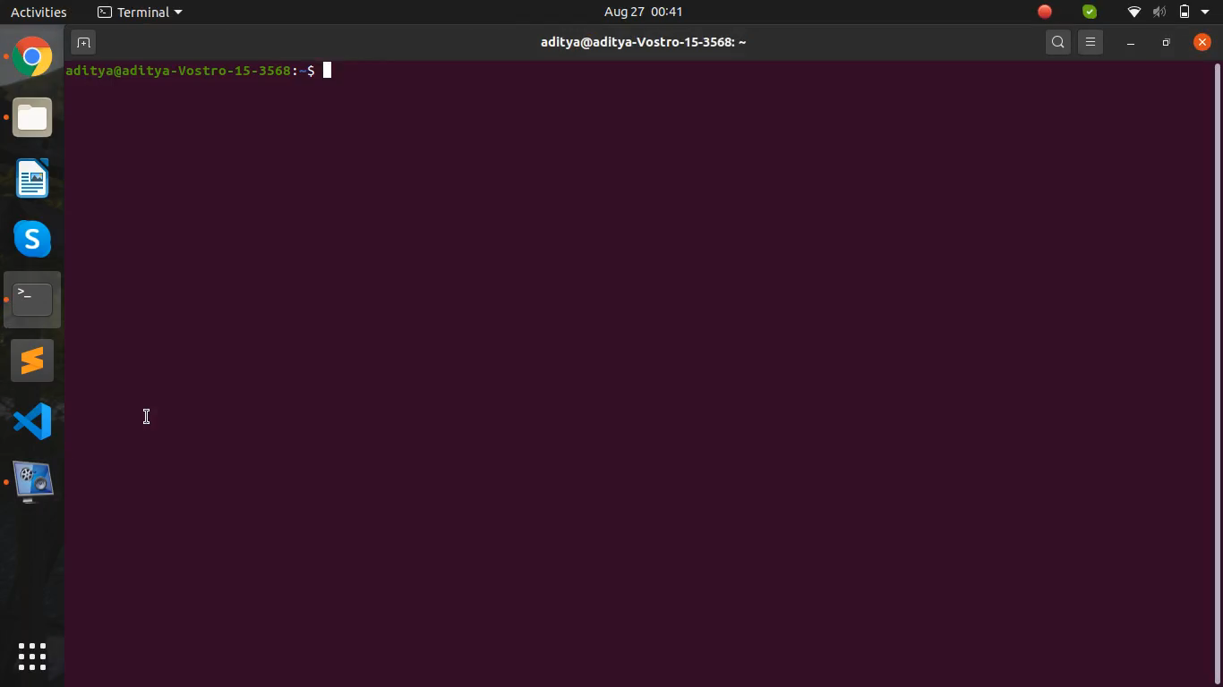
Output video

Slide 19
THANKS!

